Slide 1
INTRODUCTION TO COMPUTING
Course Code: CCINCOM/L
Heaps
Joseph Marvin R. Imperial
Faculty
Department of Computer Science
College of Computing and Information Technologies (CCIT)
National University
Joseph Marvin R. Imperial
DATA STRUCTURES AND ALGORITHMS
NU College of Computing and Information Technologies
Course Code: CCDATRCL

Slide 2
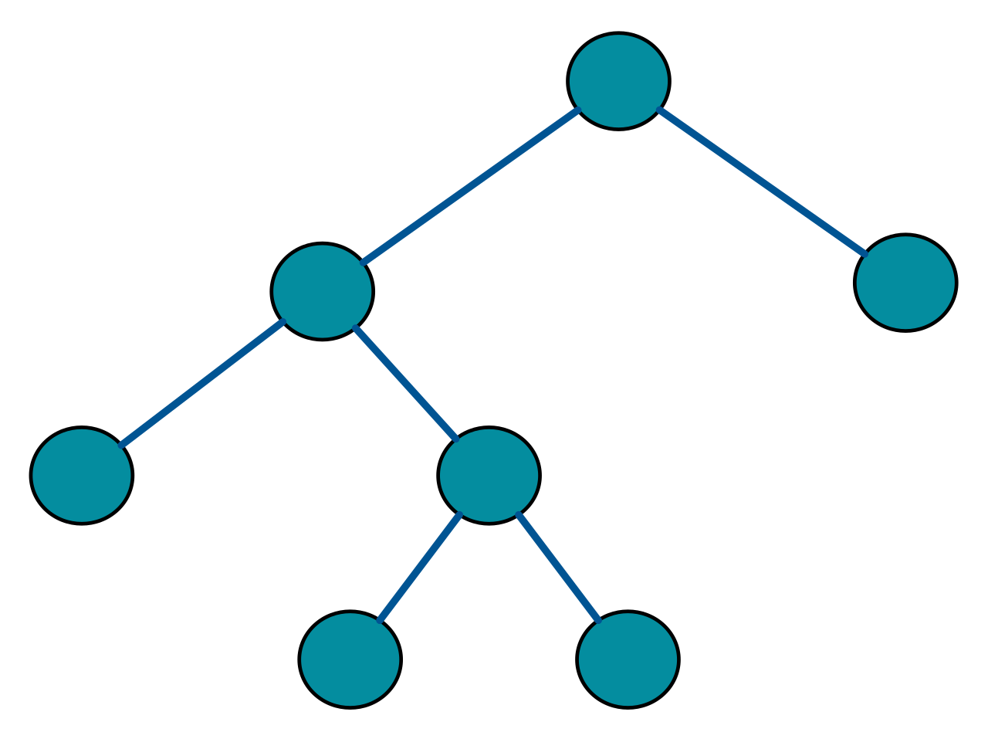
Types of binary trees
Full binary tree - a tree in which every node has either 0 or 2 children.
Joseph Marvin R. Imperial
DATA STRUCTURES AND ALGORITHMS
NU College of Computing and Information Technologies
Course Code: CCDATRCL

Slide 3
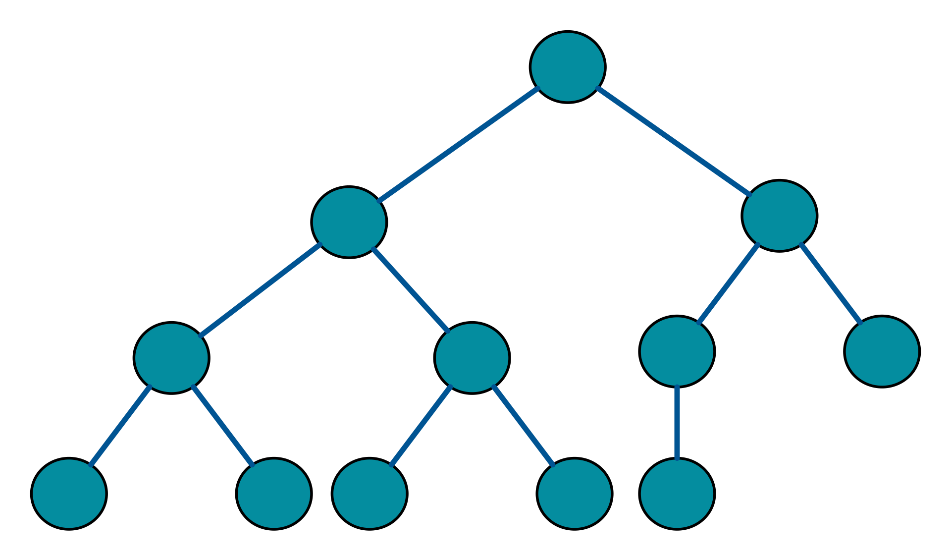
Types of binary trees
2. Complete binary tree – a tree is a binary tree in which every level, except possibly the last, is completely filled, and all nodes are as far left as possible.
Joseph Marvin R. Imperial
DATA STRUCTURES AND ALGORITHMS
NU College of Computing and Information Technologies
Course Code: CCDATRCL

Slide 4
Complete binary tree
Joseph Marvin R. Imperial
DATA STRUCTURES AND ALGORITHMS
NU College of Computing and Information Technologies
Course Code: CCDATRCL

Slide 5
The Heap
A heap is a data structure based on a binary tree with additional properties. The two properties of a heap all boils down to the shape of the tree, and the order of the tree’s nodes.
For a binary tree to qualify as a heap, its shape or structure must be complete binary tree
The order of the nodes depends on two properties:
min-heap property
max-heap property
Joseph Marvin R. Imperial
DATA STRUCTURES AND ALGORITHMS
NU College of Computing and Information Technologies
Course Code: CCDATRCL

Slide 6

In simpler words
A heap is really nothing more than a binary tree with some additional rules that it has to follow.
In a heap, the highest (or lowest) priority element is always stored at the root.
Joseph Marvin R. Imperial
DATA STRUCTURES AND ALGORITHMS
NU College of Computing and Information Technologies
Course Code: CCDATRCL

Slide 7
The Heap Properties
A binary heap is a complete binary tree which satisfies the heap ordering property. The ordering can be one of two types:
min heap property - the value of each node is greater than or equal to the value of its parent, with the minimum-value element at the root (key(α) ≤ key(β)).
max heap property - the value of each node is less than or equal to the value of its parent, with the maximum-value element at the root (key(α) ≥ key(β)).
Joseph Marvin R. Imperial
DATA STRUCTURES AND ALGORITHMS
NU College of Computing and Information Technologies
Course Code: CCDATRCL

Slide 8
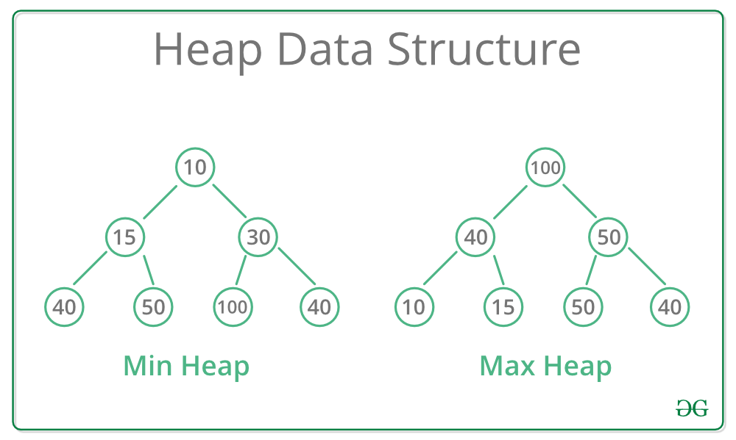
Joseph Marvin R. Imperial
DATA STRUCTURES AND ALGORITHMS
NU College of Computing and Information Technologies
Course Code: CCDATRCL

Slide 9
Constructing a heap
The algorithm below is for creating a max heap by inserting one element at a time. At any point of time, heap must maintain its property. While insertion, we also assume that we are inserting a node in an already heapified tree.
Create a new node at the end of heap.
Assign new value to the node.
Compare the value of this child node with its parent.
If value of parent is less (greater) than child, then swap them.
Repeat step 3 & 4 until Heap property holds.
Joseph Marvin R. Imperial
DATA STRUCTURES AND ALGORITHMS
NU College of Computing and Information Technologies
Course Code: CCDATRCL

Slide 10
Constructing a heap
Joseph Marvin R. Imperial
DATA STRUCTURES AND ALGORITHMS
NU College of Computing and Information Technologies
Course Code: CCDATRCL

Slide 11
Try constructing a heap
Min and max heap:
1. 4, 1, 6, 10, 11, 13, 5, 2
2. 36, 21, 23, 29, 31, 34, 24, 15, 49
Joseph Marvin R. Imperial
DATA STRUCTURES AND ALGORITHMS
NU College of Computing and Information Technologies
Course Code: CCDATRCL

Slide 12
Inserting to a heap
After adding, to preserve the heap property, a bubble-up or heapify-up operation is performed if needed. The insertion is performed in the following manners:
The following algorithm shows how to insert an element to a heap:
Add the new node in the bottom level as the last node of the heap.
Compare the added node with its parent. If the parent is smaller/larger than the added node, stop! The heap property is reserved.
And if the added node is smaller/larger then its parent node, swap the nodes and continue from step 2.
Joseph Marvin R. Imperial
DATA STRUCTURES AND ALGORITHMS
NU College of Computing and Information Technologies
Course Code: CCDATRCL

Slide 13
Inserting to a heap
Joseph Marvin R. Imperial
DATA STRUCTURES AND ALGORITHMS
NU College of Computing and Information Technologies
Course Code: CCDATRCL

Slide 14
Removing from a heap
You can only remove the root/top of the heap. Nothing more.
The following algorithm shows how to safely remove from a heap:
Delete the root (this creates a hole and the tree is no longer complete)
Replace the deletion node with the farthest right node on the lowest level of the tree (this step makes the tree into a "complete binary tree")
Heapify accordingly to the property (min or max)
Joseph Marvin R. Imperial
DATA STRUCTURES AND ALGORITHMS
NU College of Computing and Information Technologies
Course Code: CCDATRCL

Slide 15
Removing from a heap
Joseph Marvin R. Imperial
DATA STRUCTURES AND ALGORITHMS
NU College of Computing and Information Technologies
Course Code: CCDATRCL

Slide 16
Removing from a heap
Joseph Marvin R. Imperial
DATA STRUCTURES AND ALGORITHMS
NU College of Computing and Information Technologies
Course Code: CCDATRCL

Slide 17
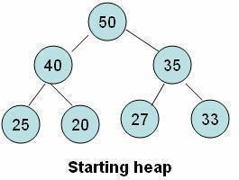
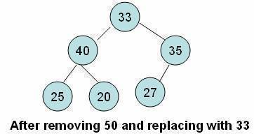
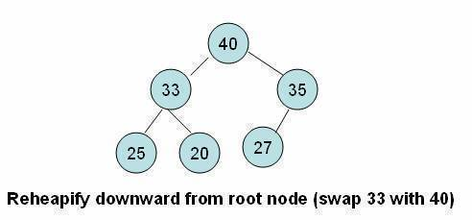
Removing from a heap
Joseph Marvin R. Imperial
DATA STRUCTURES AND ALGORITHMS
NU College of Computing and Information Technologies
Course Code: CCDATRCL

Slide 18
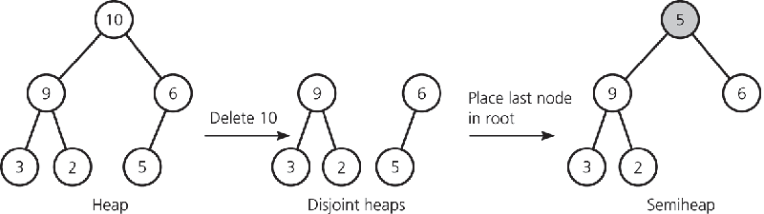
Removing from a heap
What’s next? Are we done?
Joseph Marvin R. Imperial
DATA STRUCTURES AND ALGORITHMS
NU College of Computing and Information Technologies
Course Code: CCDATRCL

Slide 19
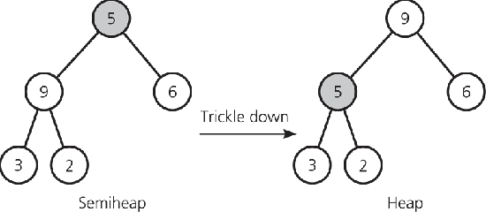
Removing from a heap
We have to fix the heap based on the property.
Trickle down – process of moving down the node to its correct position
Joseph Marvin R. Imperial
DATA STRUCTURES AND ALGORITHMS
NU College of Computing and Information Technologies
Course Code: CCDATRCL

Slide 20
Heap in an array
If we wish to represent a partially complete binary tree, and we know its maximum size beforehand, an array is often the preferred representation.
The root is at position 0 in the array. The root's children are at positions 1 and 2. The children of these nodes then follow in left-to-right order...
If given the index i to any particular node, you access that node's data using the formulas:
The node's parent: i/2
The node's left child (if it exists): (2*i)
The node's right child (if it exists): (2*i) + 1
Joseph Marvin R. Imperial
DATA STRUCTURES AND ALGORITHMS
NU College of Computing and Information Technologies
Course Code: CCDATRCL

Slide 21
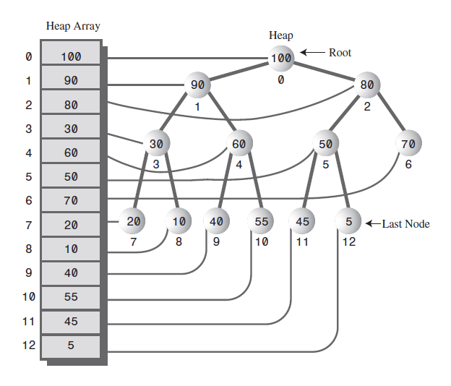
Joseph Marvin R. Imperial
DATA STRUCTURES AND ALGORITHMS
NU College of Computing and Information Technologies
Course Code: CCDATRCL

Slide 22
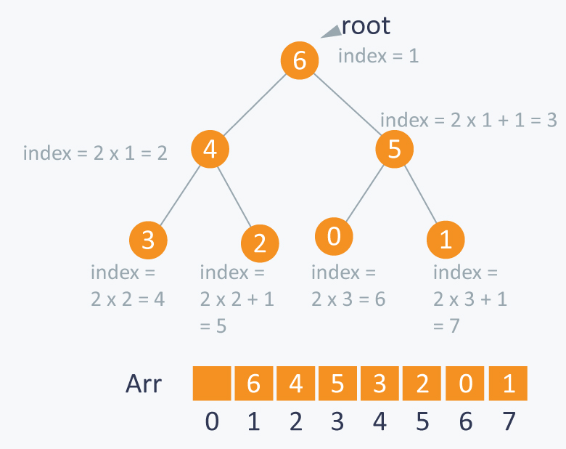
Joseph Marvin R. Imperial
DATA STRUCTURES AND ALGORITHMS
NU College of Computing and Information Technologies
Course Code: CCDATRCL

Slide 23
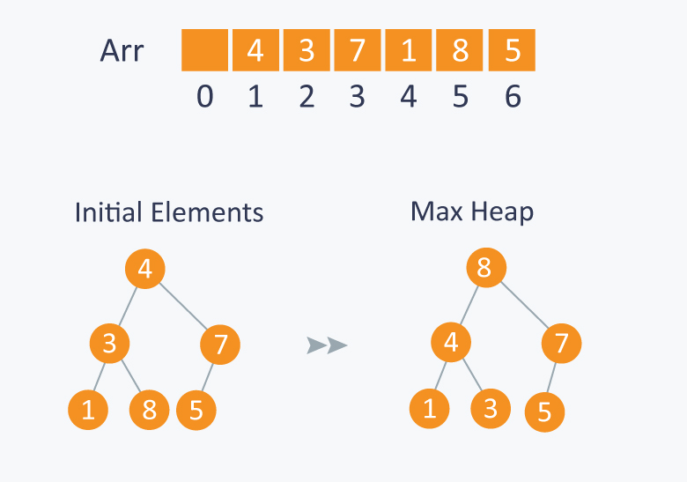
Sample
Joseph Marvin R. Imperial
DATA STRUCTURES AND ALGORITHMS
NU College of Computing and Information Technologies
Course Code: CCDATRCL

Slide 24
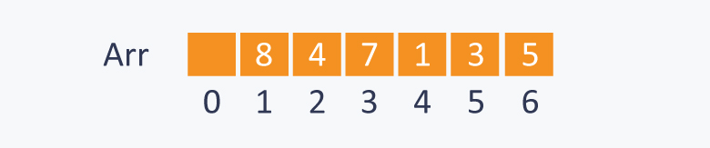
After building max-heap, the elements in the array will be:
Joseph Marvin R. Imperial
DATA STRUCTURES AND ALGORITHMS
NU College of Computing and Information Technologies
Course Code: CCDATRCL

Slide 25
Try constructing a heap
Min and max heap:
1. 4, 1, 6, 10, 11, 13, 5, 2
2. 36, 21, 23, 29, 31, 34, 24, 15, 49
Delete:
Call delete() twice, show the resulting heap
Call delete() thrice, show resulting heap
Joseph Marvin R. Imperial
DATA STRUCTURES AND ALGORITHMS
NU College of Computing and Information Technologies
Course Code: CCDATRCL

Slide 26
References
Heaps – Carnegie Mellon University: https://www.cs.cmu.edu/~adamchik/15-121/lectures/Binary%20Heaps/heaps.html
Loving Heaps: https://medium.com/basecs/learning-to-love-heaps-cef2b273a238
Joseph Marvin R. Imperial
DATA STRUCTURES AND ALGORITHMS
NU College of Computing and Information Technologies
Course Code: CCDATRCL

